Slide 1
The Golden Splash Swimming Center
Daniel Galin
Software Quality Assurance - From Theory to Implementation
Pearson Education, 2004

Slide 2
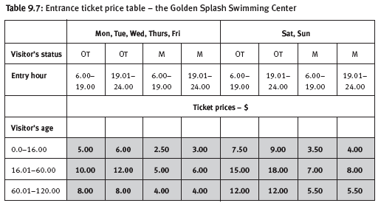

Slide 3
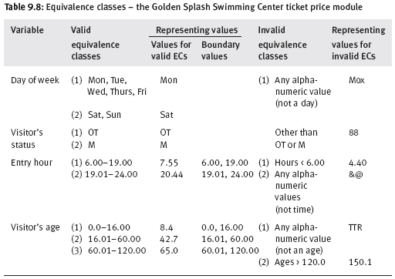

Slide 4
